Slide 1

Agenda
Project 1 winners!
Learning objectives for programming projects
Quizzes
https://rednuht.org/genetic_cars_2/
Divided rectangles
Stochastic methods (Chapter 8)
Population methods (Chapter 9)

Slide 2
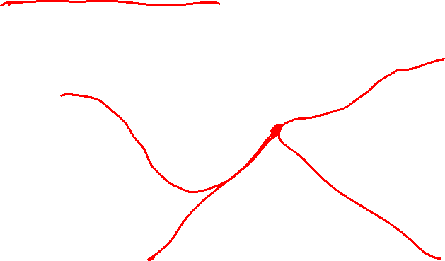
Divided Rectangles
Also called DIRECT for Divided RECTangles
Same approach as Shubert-Piyavskii method, but does not need to specify Lipschitz constant and is more efficiently expanded to multiple dimensions

Slide 3
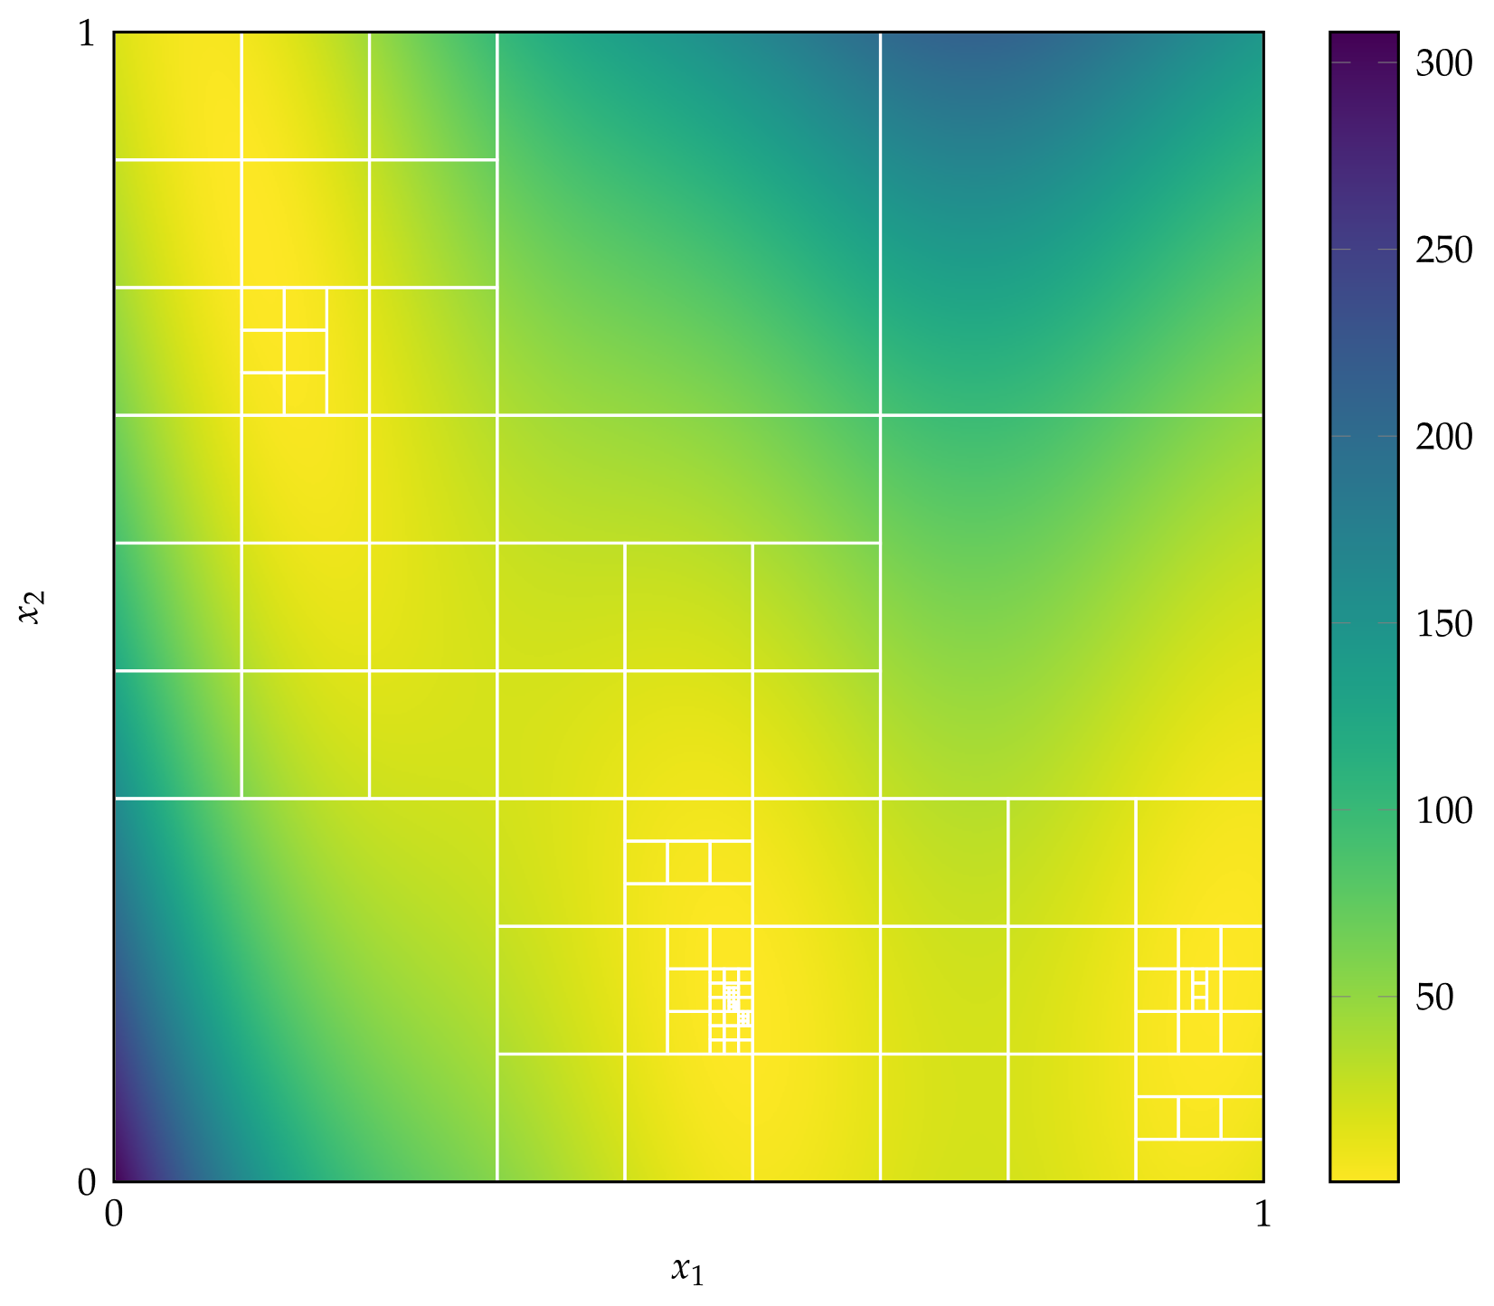

Divided Rectangles

Slide 4
Stochastic Methods

Slide 5
Stochastic Methods
Employ randomness strategically to help explore design space
Randomness can help escape local minima
Increases chance of searching near the global minimum
Typically rely on pseudo-random number generators to ensure repeatability

Slide 6
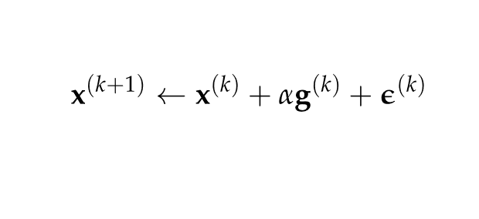
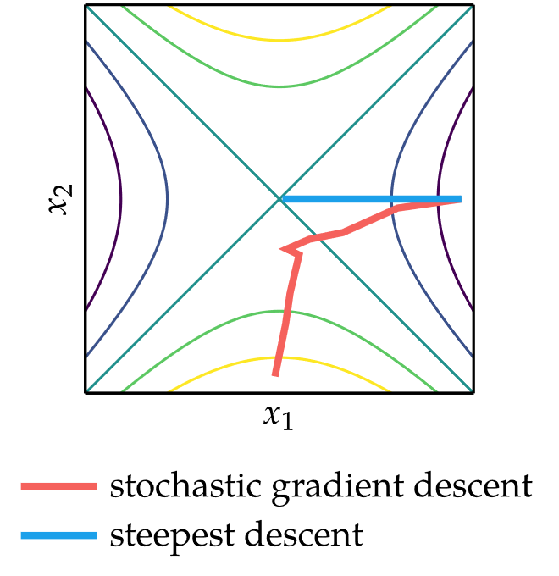
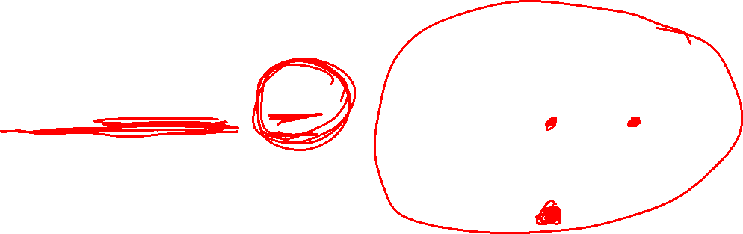
Noisy Descent
Gradient descent with additional random noise term
Step size must meet certain conditions to guarantee convergence

Slide 7
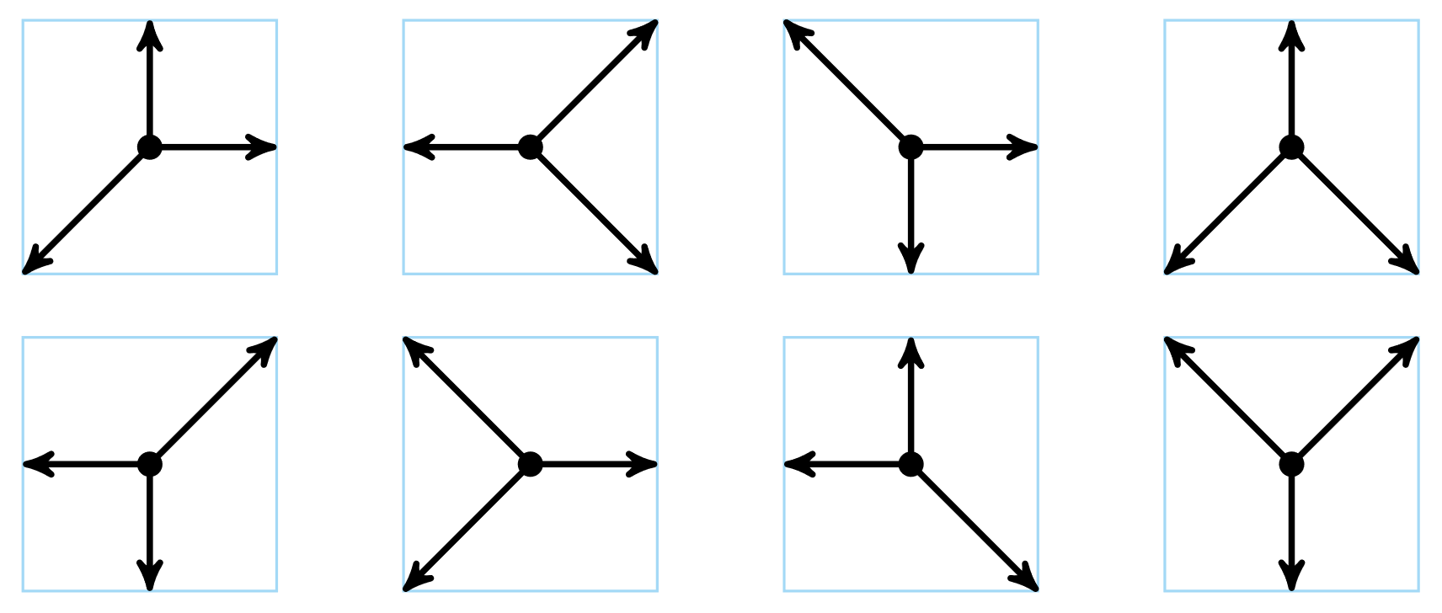
Mesh Adaptive Direct Search
Similar to generalized pattern search method, but searches in a random set of directions that span the search space
Example: set of positive spanning sets constructed from nonzero directions d₁,d₂ ∊{-1,0,1}

Slide 8
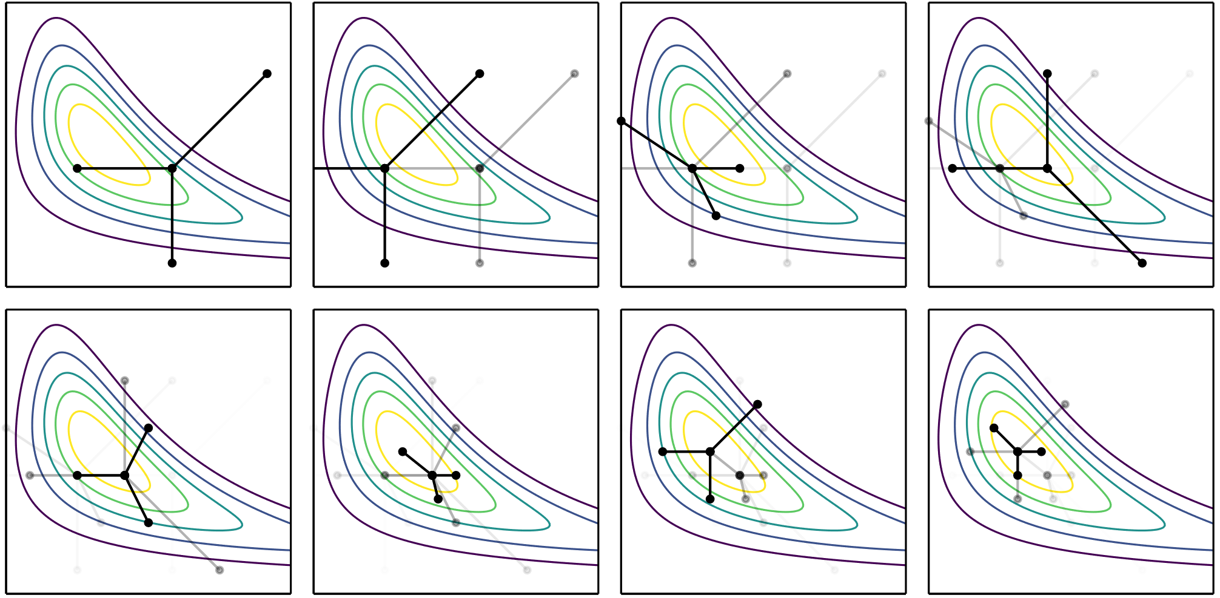
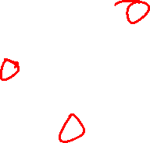
Mesh Adaptive Direct Search

Slide 9
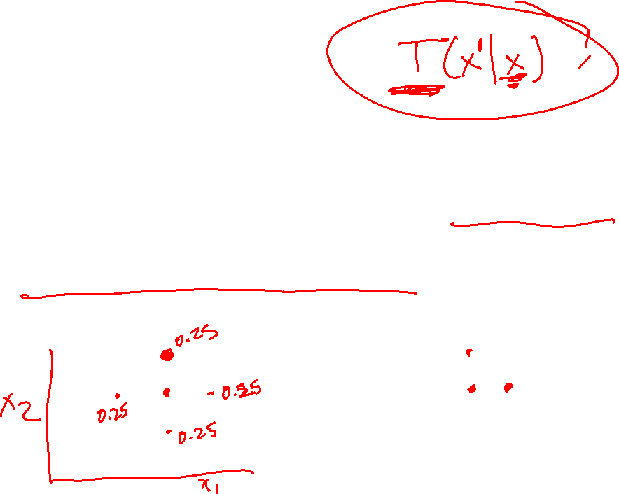
Simulated Annealing
Intelligently controls the degree of randomness added to stochastic search methods
Randomness is analogous to temperature in metallurgy
Initially, the randomness added to function evaluations is large
The “temperature” is then slowly lowered according to a predetermined “annealing schedule”

Slide 10
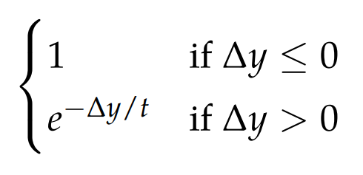
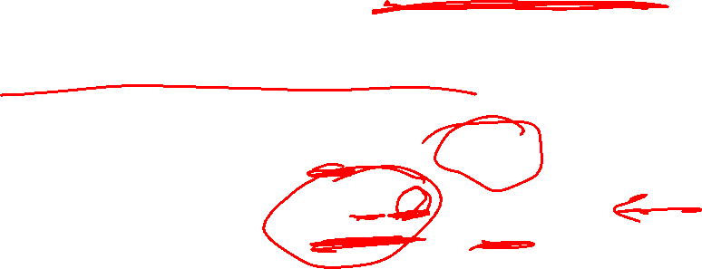
Simulated Annealing
Each step must then be “accepted” as the new design point with probability defined by the Metropolis criterion, helping the algorithm escape local minima
Metropolis criterion probability of acceptance

Slide 11
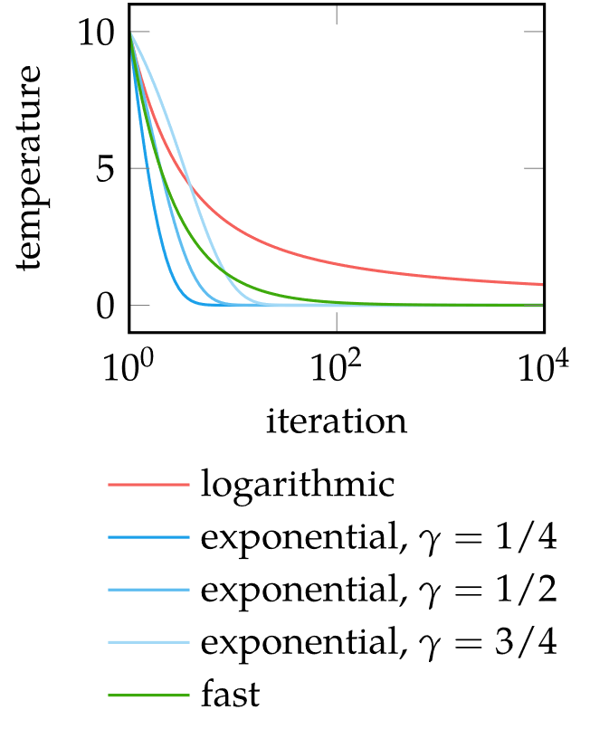
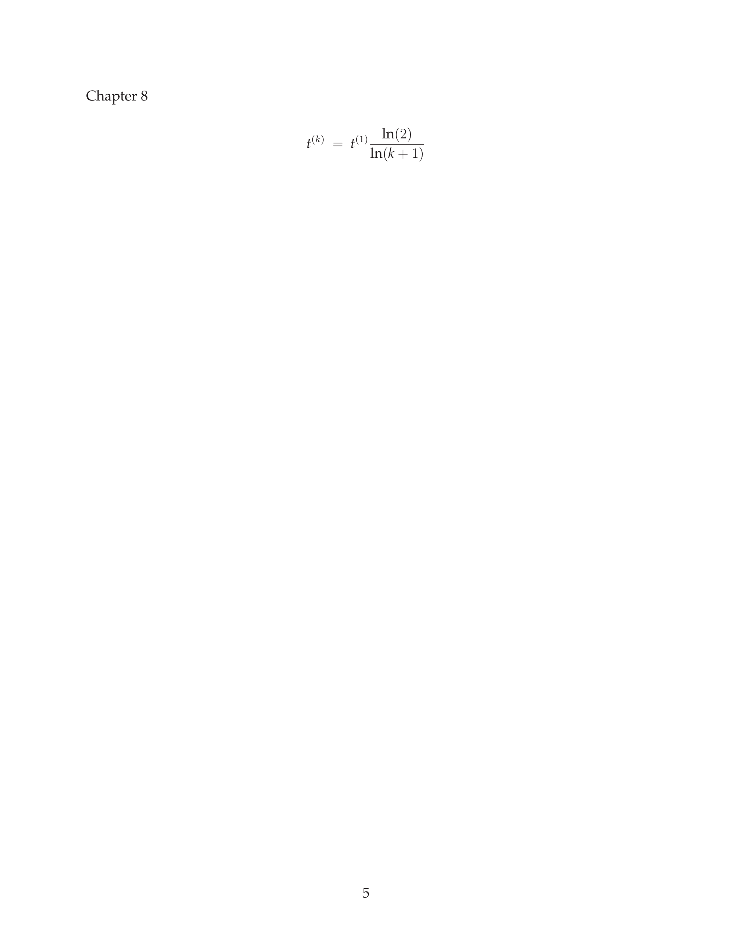


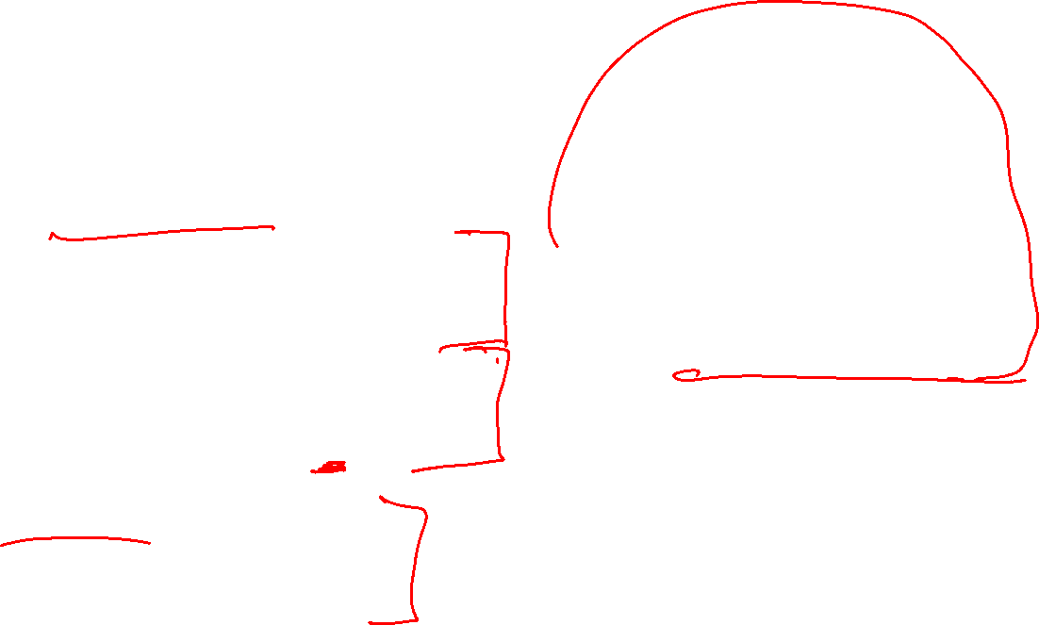
Simulated Annealing
Annealing schedules
Logarithmic annealing schedule
Exponential annealing schedule
Fast annealing

Slide 12

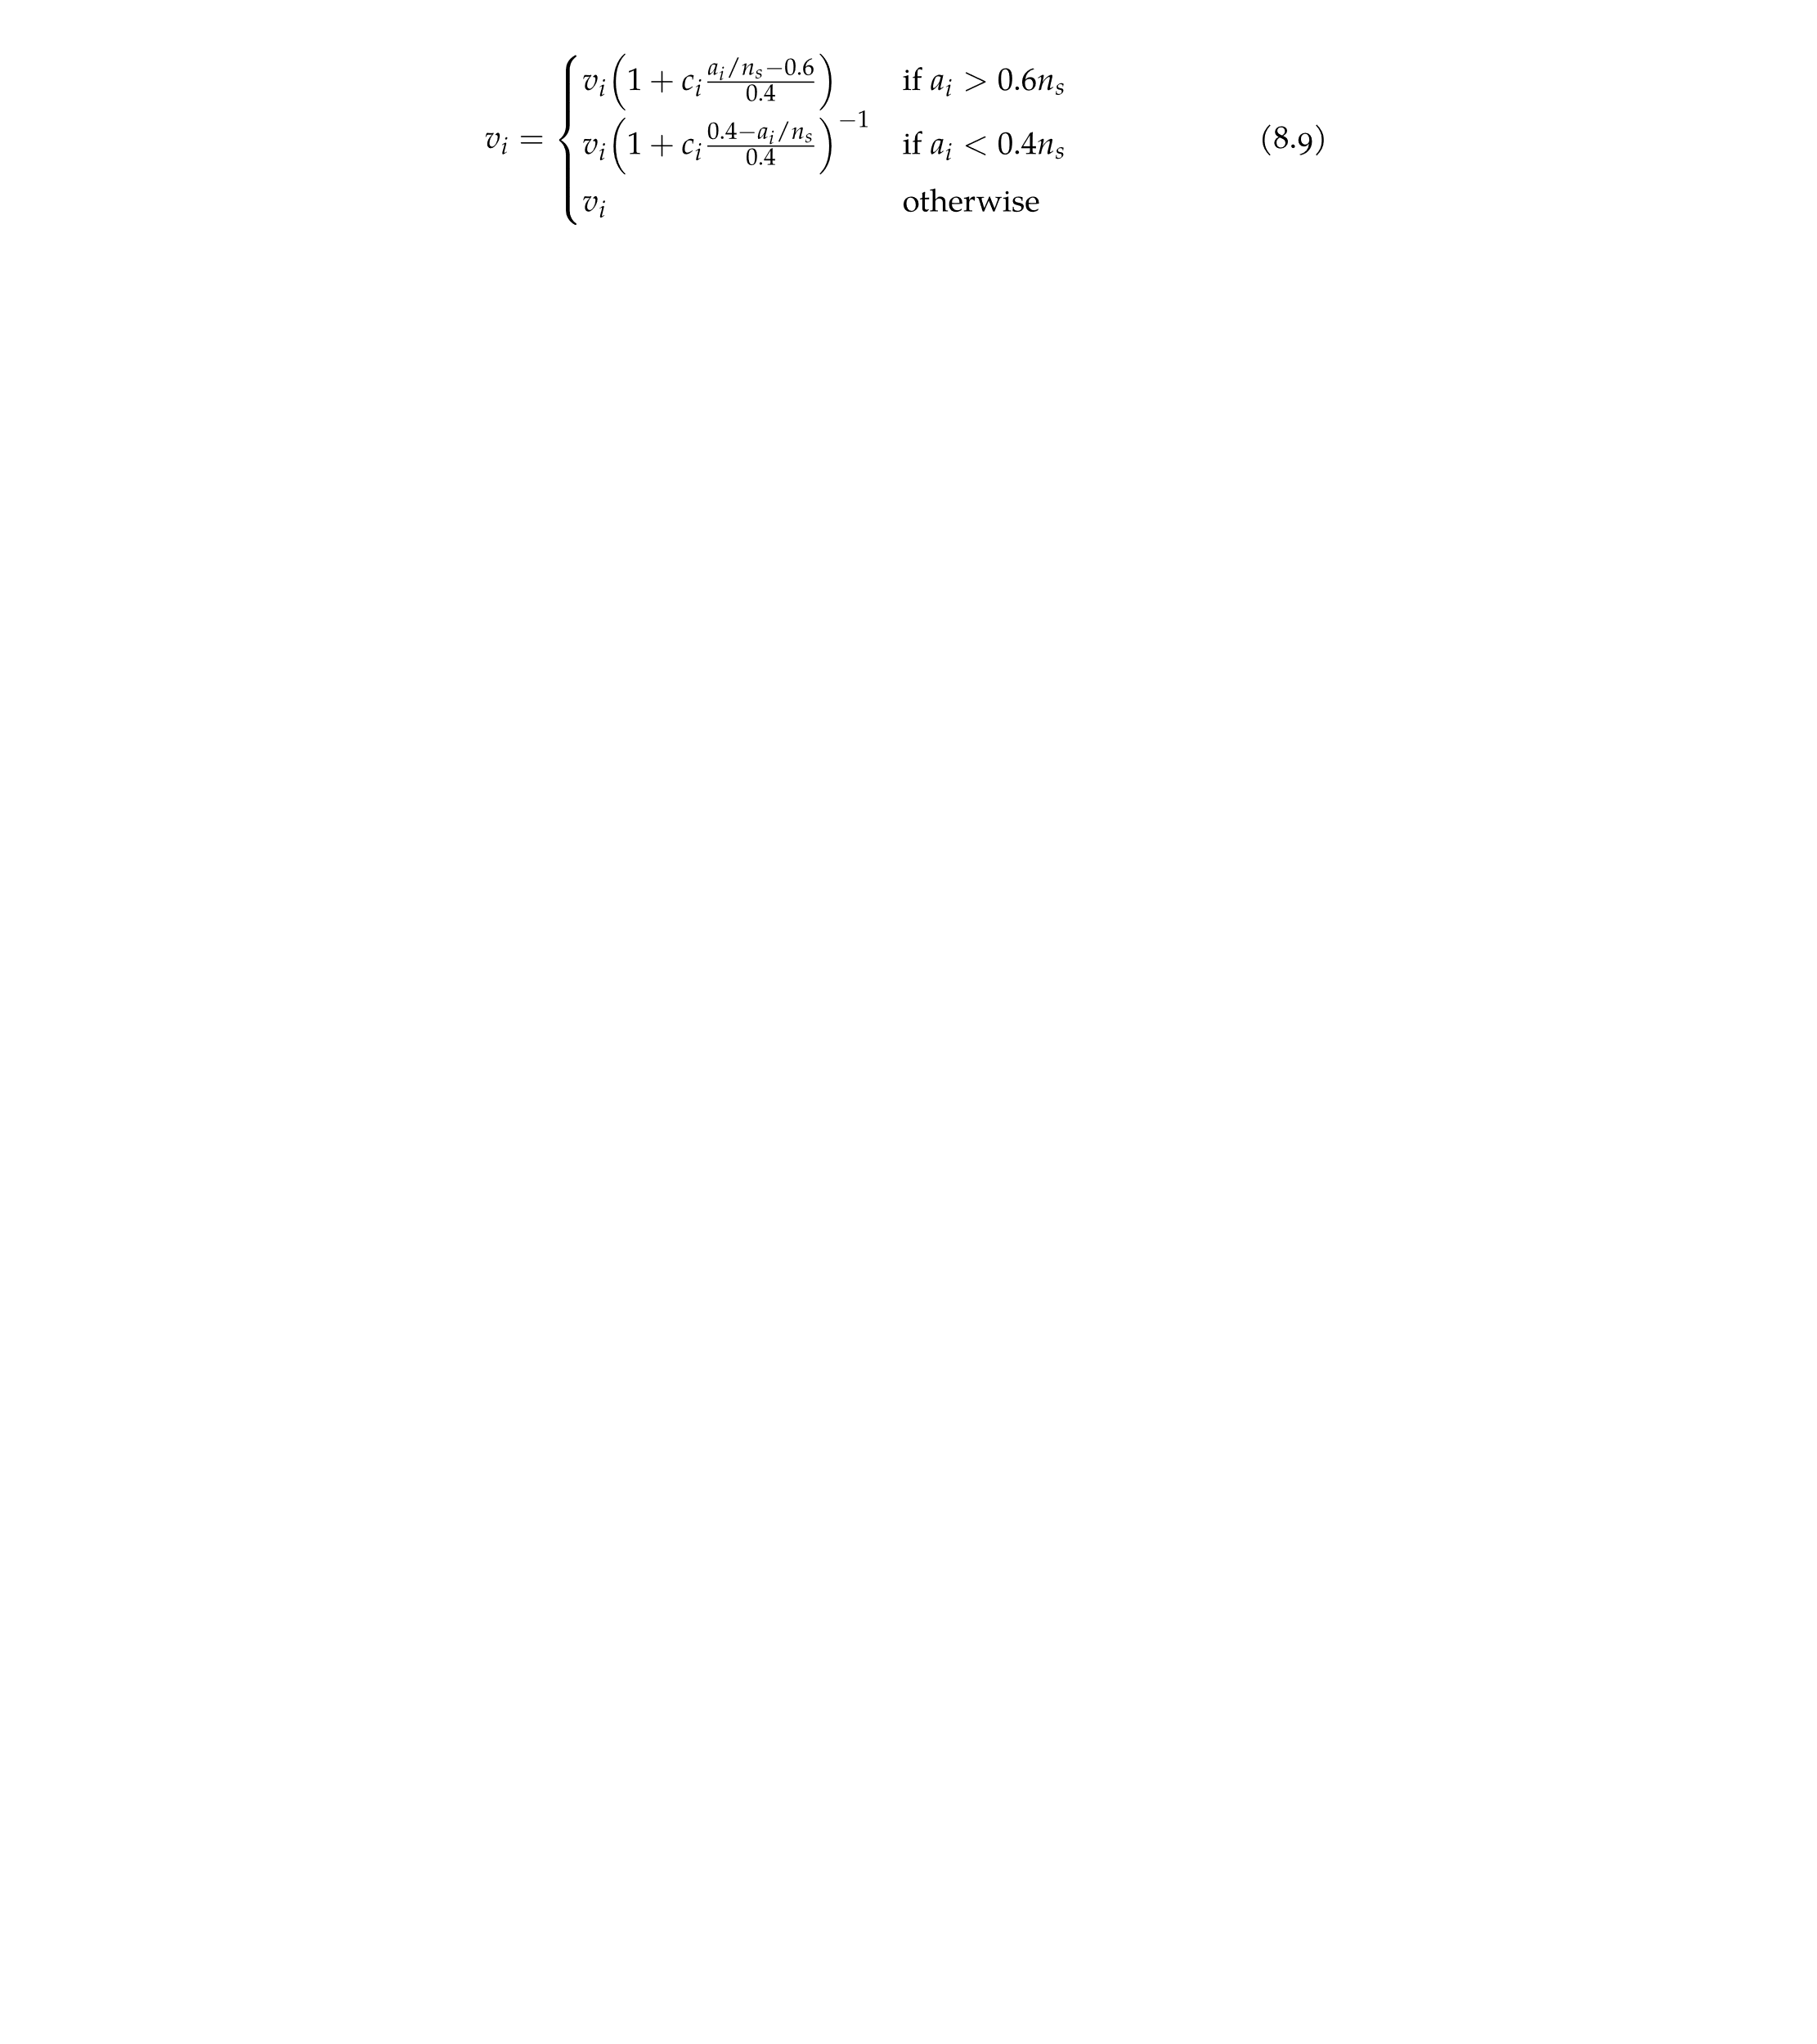
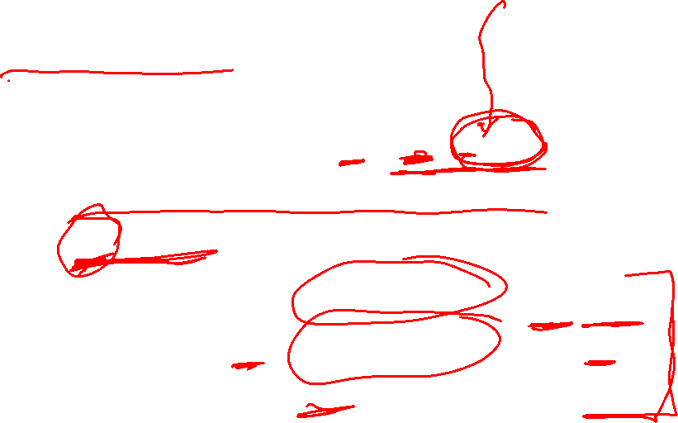
Simulated Annealing
Corana et al. 1987 introduced variable step-size
First, a cycle of random moves is performed in each direction
where r is randomly sampled from [-1,1]
After n_{s} cycles, step size is adjusted according to
where c is typically set to 2

Slide 13
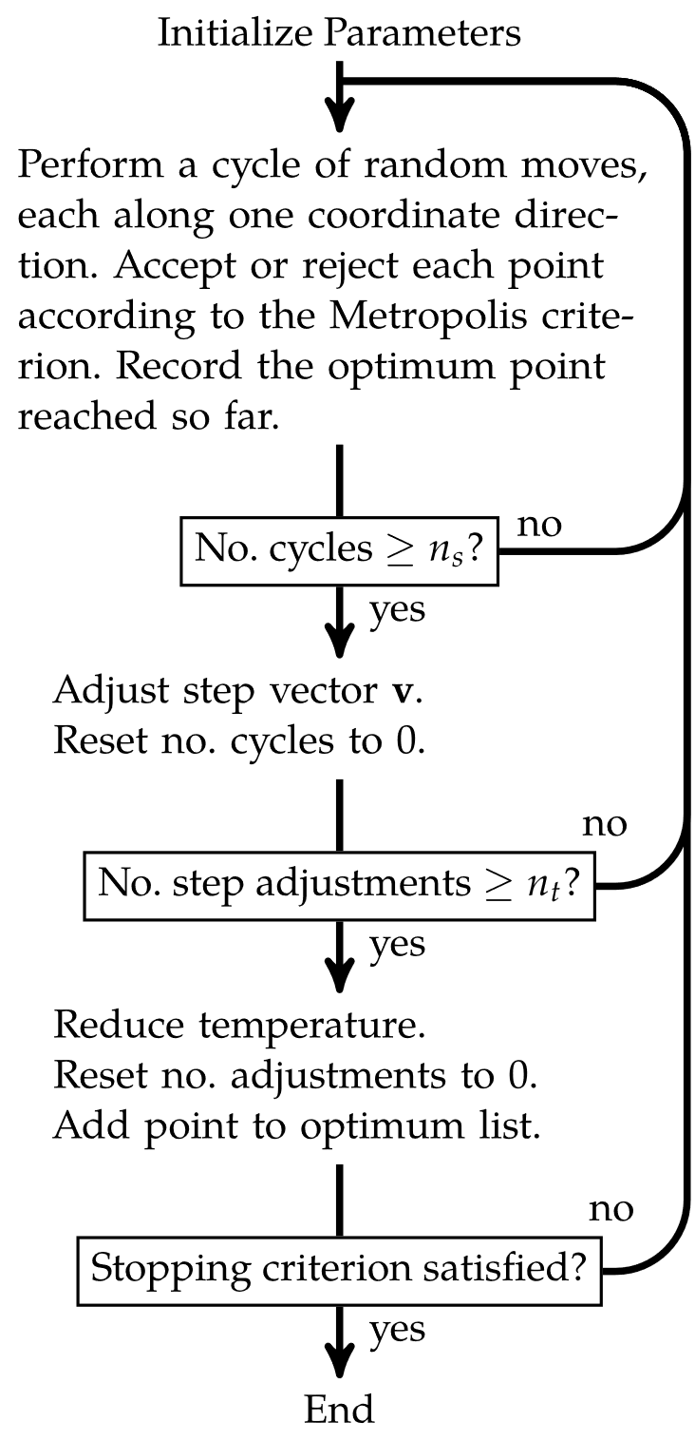
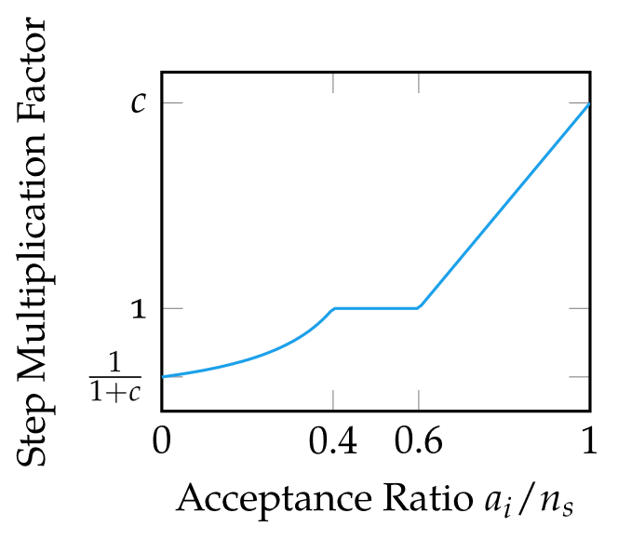

Simulated Annealing
The variable step size introduced by Corana et al. 1987 regulates the ratio of accepted-to-rejected points to about 50%

Slide 14
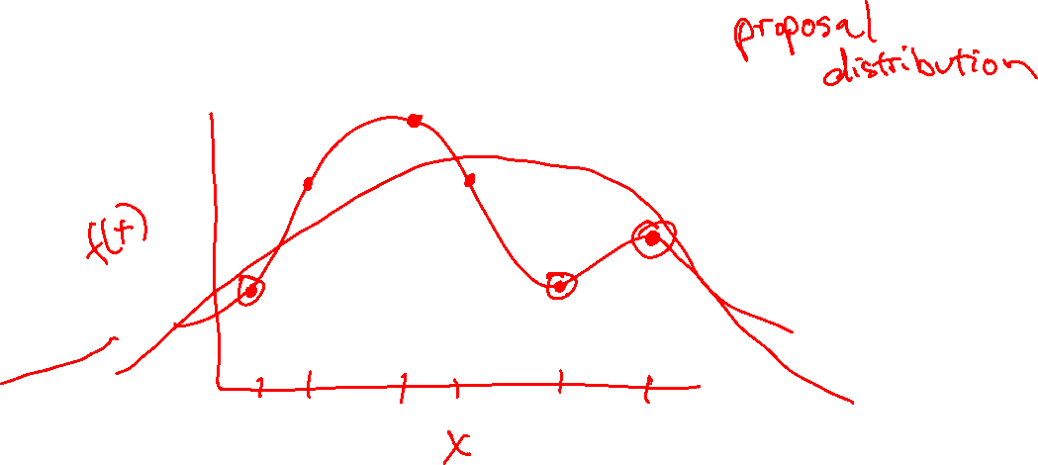
Cross-Entropy Method

Slide 15
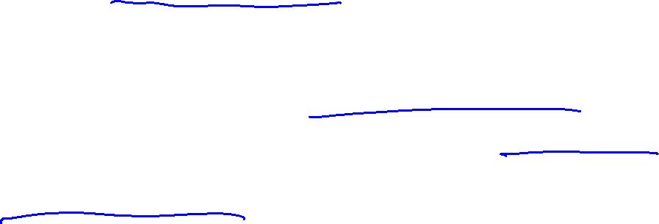
Cross-Entropy Method
Maintains explicit probability distribution over design space often called a proposal distribution
Requires choosing a family of parameterized distributions
At each iteration, a set of design points are sampled from the proposal distribution; these are evaluated and ranked
The best-performing subset of samples, called elite samples, are retained
The proposal distribution parameters are then updated based on the elite samples, and the next iteration begins

Slide 16
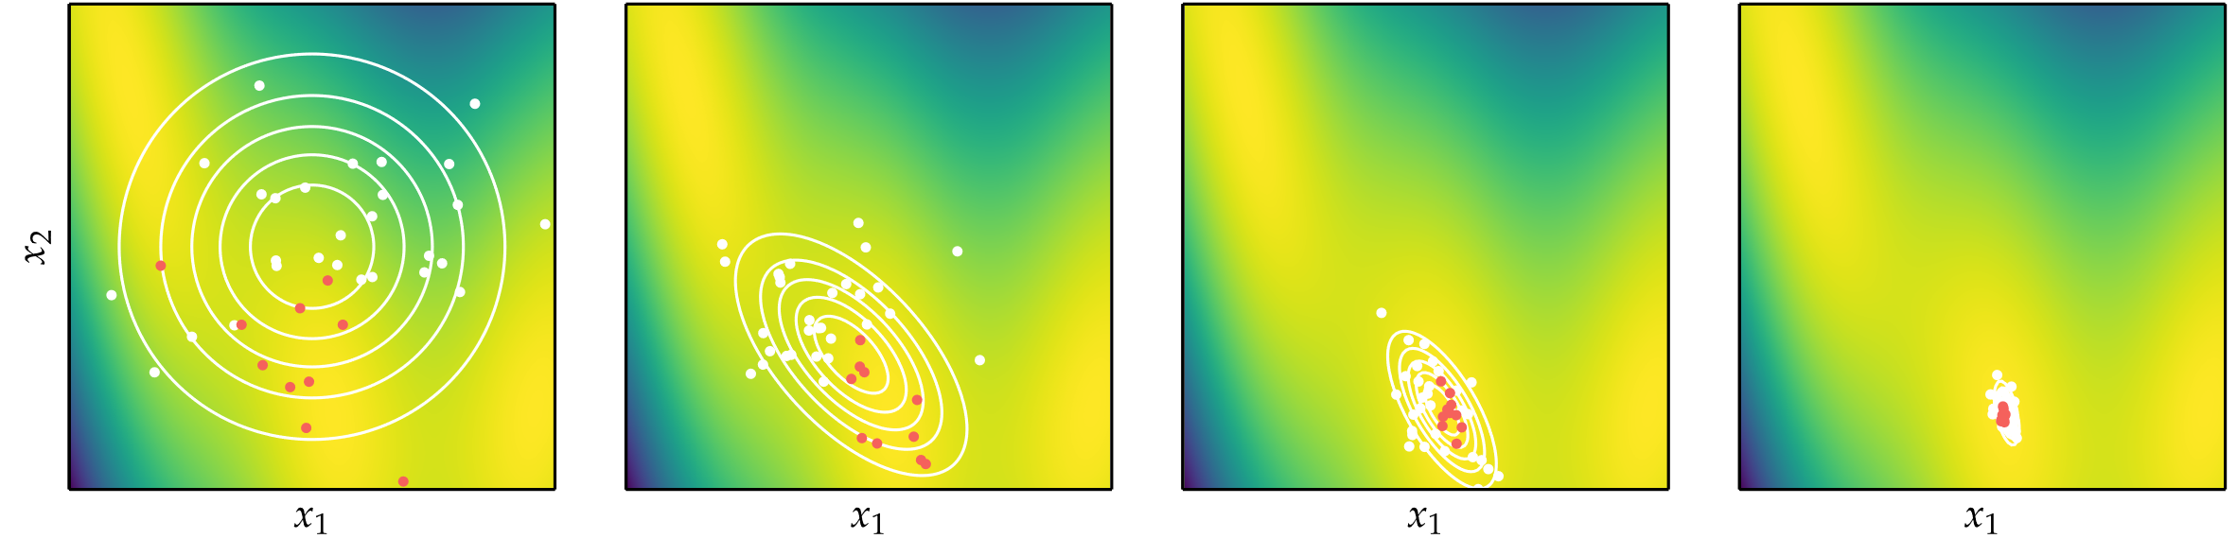
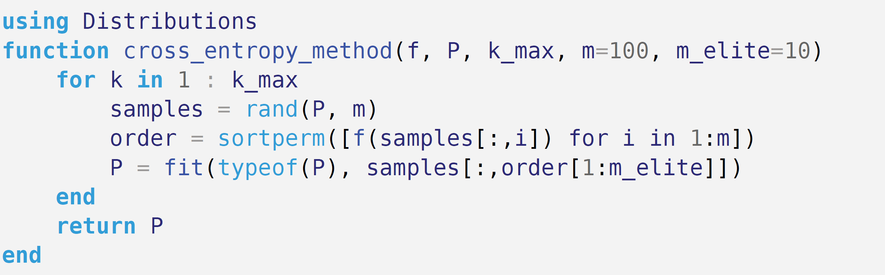
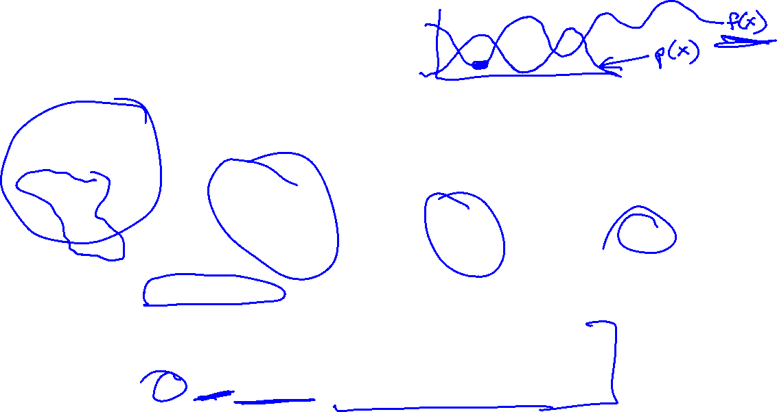
Cross-Entropy Method

Slide 17
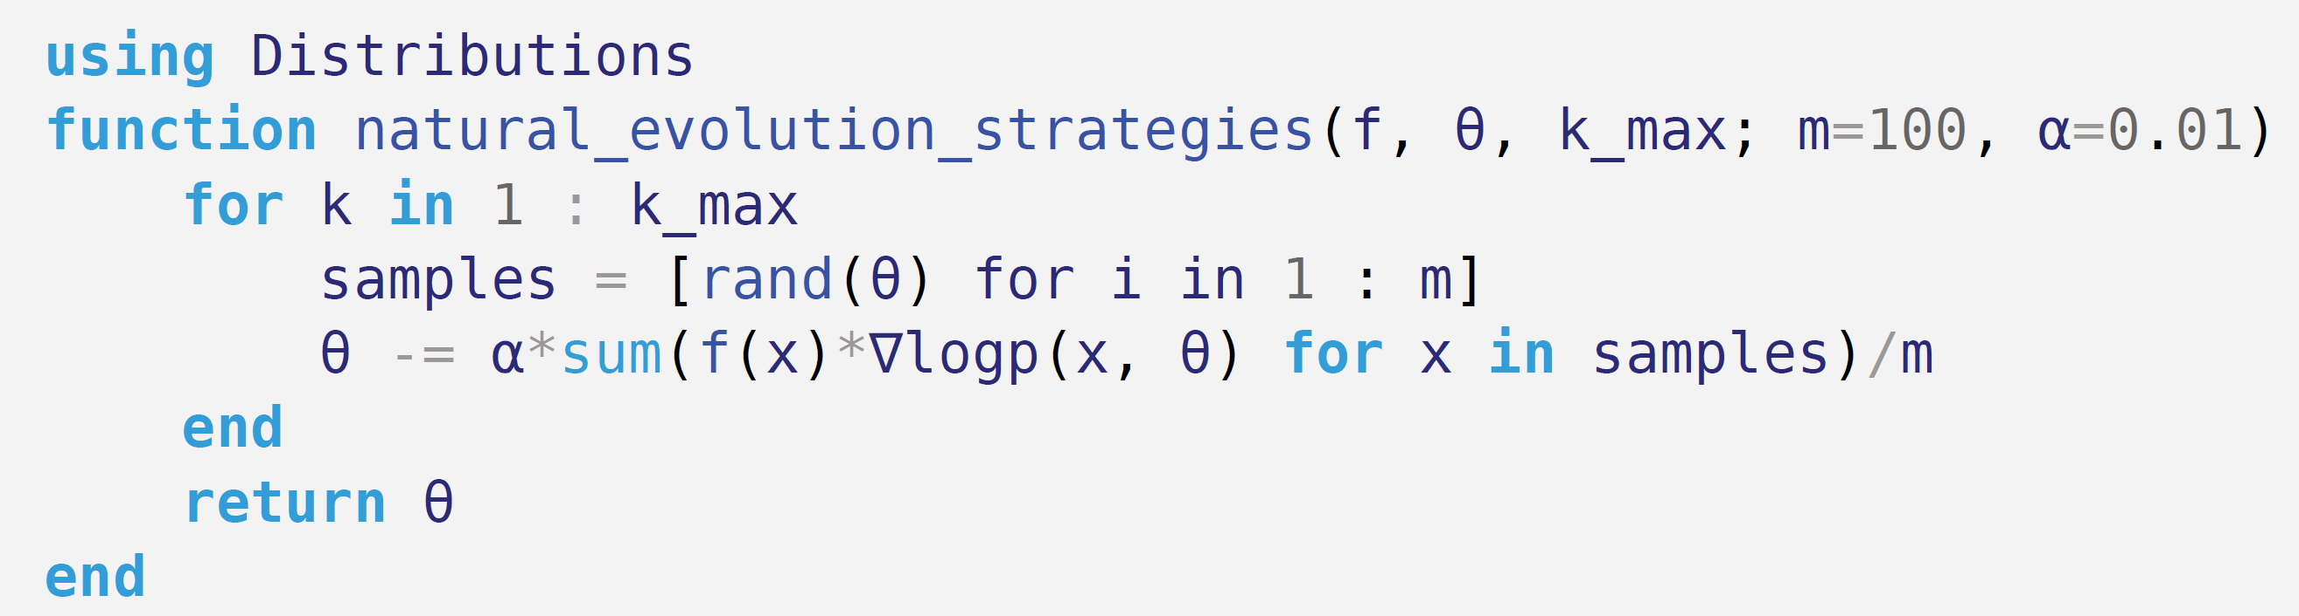
Natural Evolution Strategies
Similar to cross-entropy method, except instead of parameterizing distribution based on elite samples, it is optimized using gradient descent
The distribution parameter gradient is estimated from the set of function evaluations

Slide 18
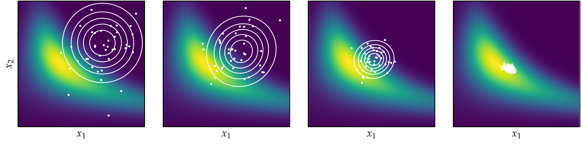
Natural Evolution Strategies

Slide 19
Covariance Matrix Adaptation
Same approach as natural evolution strategy and cross entropy method, but the proposal distribution is a multivariate Gaussian parameterized by a covariance matrix
Sample efficient

Slide 20
Summary
Stochastic methods employ random numbers during the optimization process
Simulated annealing uses a temperature that controls random exploration and which is reduced over time to converge on a local minimum
The cross-entropy method and evolution strategies maintain proposal distributions from which they sample in order to inform updates

Slide 21
Summary
Natural evolution strategies uses gradient descent with respect to the log likelihood to update its proposal distribution
Covariance matrix adaptation is a robust and sample-efficient optimizer that maintains a multivariate Gaussian proposal distribution with a full covariance matrix

